Slide 1

Masaccio - Monitoring for urbAn Safety with the IoT
VAS Group
Valentina Cecchini - mat.: 255596
Andrea Perelli - mat.: 254758
Stefano Valentini - mat.: 254825

Slide 2

Application Domain
The Architecture that we are proposing is designed to be adaptable to various situations. We decided to instantiate the problem to the monitoring of the UnivAQ’s existing buildings.
Our Architecture is designed to manage and monitor emergencies that may occur in the different places of UnivAQ’s building, manage accesses to restricted areas and perform analysis on collected data.

Slide 3




Main services
The main services we want to provide are:
Access control
Security monitoring
Alarm dispatching
Smart Information Service
Crowd Monitoring
Data Storing and Analysis
Attendance Registration

Slide 4
Design Decisions (1)
Data Acquisition: we have chosen the Publish/Subscribe architectural pattern, in particular we have used Apache Kafka.
Pro: reliability, fault-tolerance, performance, scalability.
Storing: we decided to store the collected data in the UnivAQ’s server. In particular, we organised them in two different DB: a NoSQL DB (MongoDB) and a relational DB.
Pro: scalability, dependability, costs efficiency, privacy/security, performance.

Slide 5
Design Decisions (2)
Sensors and Actuators organisation: we have chosen to organise the sensors in areas (classrooms, laboratories, …). Each sensor publishes the collected data on the topic of the specific area in which it is deployed.
Pro: scalability, decoupling.
Visualisation and analysis: A dedicated Kafka Client is responsible to read the incoming data from the area topics and transmit them in real time with a secure connection to a dashboard (through web-socket). The data can even be subjected to analysis and refactoring before being sent to the dashboard, the eventual alarms are displayed on the dashboard and double checked by the personnel before being forwarded.
Pro: false alarms avoidance, real-time monitoring/graphical visualization.

Slide 6
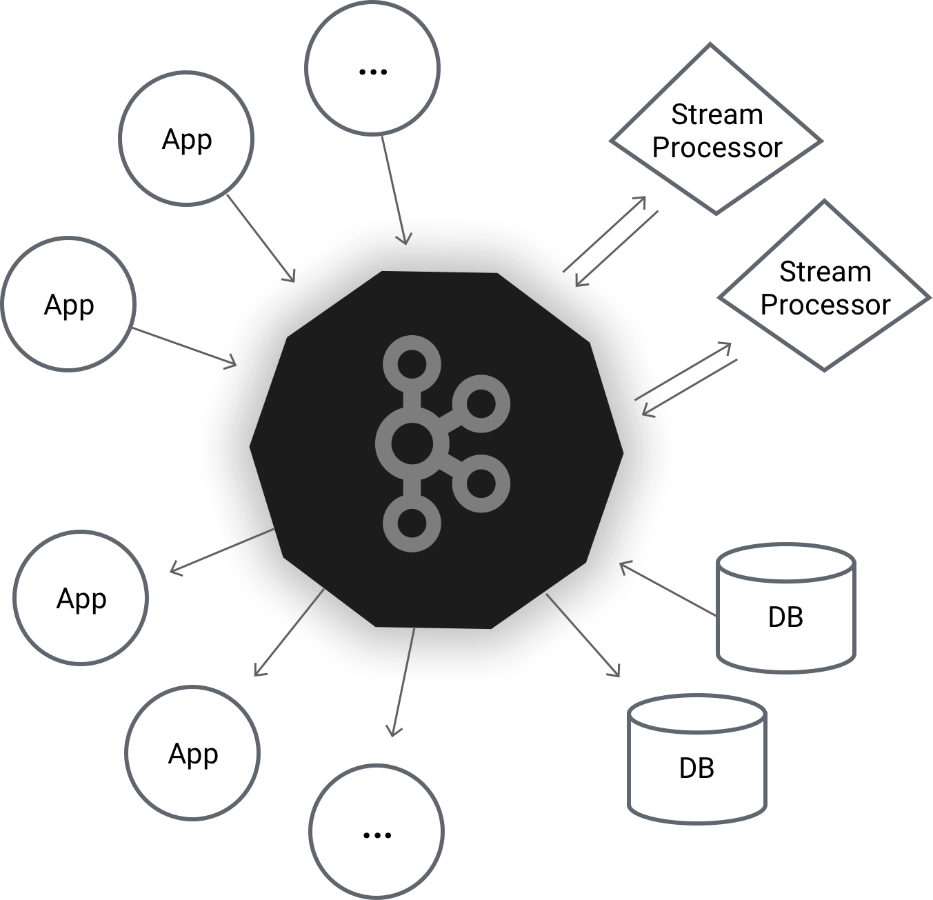
Architectural core: Apache Kafka
Apache Kafka allows to implement secure real-time streaming data pipelines that reliably get data between systems or applications.
Kafka can be used to stream data, as a message dispatcher and as a storage system it also allow for a throughput of millions of records/second, replication, redundancy, scalability, decentralisation and fault tolerance techniques that are the crucial points of our system, such as:
in case of a cluster fails another one takes its place, with all the updated data: every member of the cluster has all the replicated/up-to-date data;
data can be saved for an arbitrary amount of time on the brokers;
for a topic with replication factor N, it will tolerate up to N-1 server failures without losing any records committed to the log;
Kafka replicates the log for each topic's partitions across a configurable number of servers. This allows automatic failover to these replicas when a server in the cluster fails, so messages remain available in the presence of failures.

Slide 7
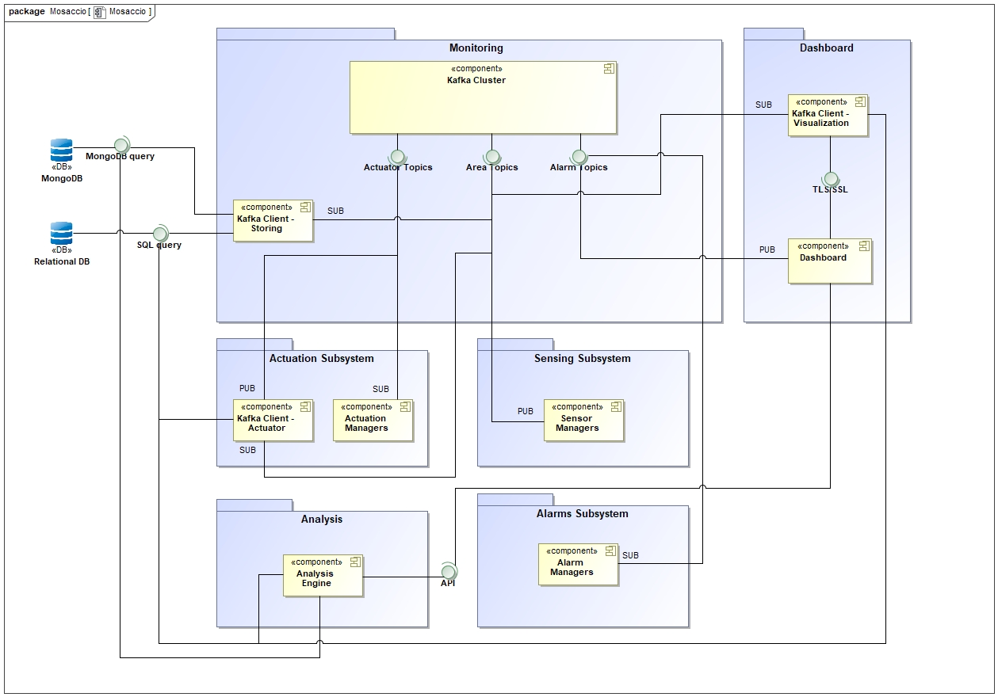
System Architecture
The system is composed by a Sensor Network, an Actuators Network, a Kafka Cluster, two DB (NoSQL and Relational), an Administration Dashboard and three Kafka Clients (Storing, Visualize and Actuator).

Slide 8
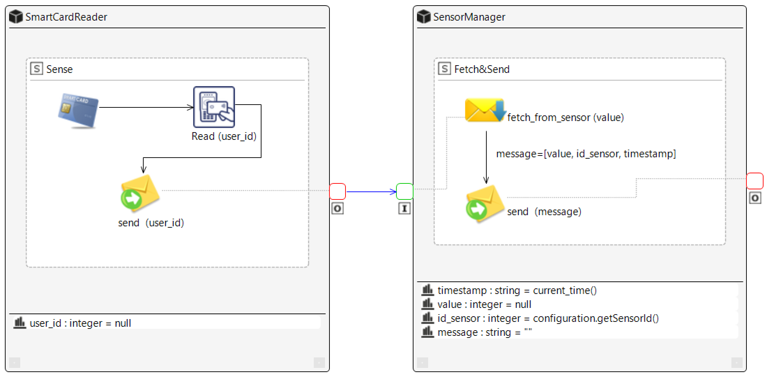
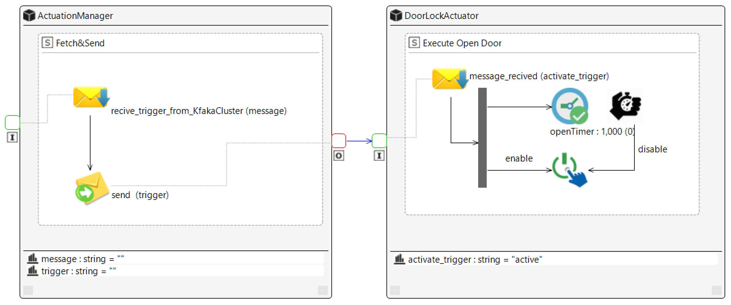
CAPS - SAML
In our system a sensor simply senses the environment and broadcast the sensed value to its Sensor Manager. The Sensor Manager publishes the message on the respective Kafka Topic along with the sensor id and the current time stamp.
Similarly, when the Actuation Manager receives a triggering message (by listening on the respective Kafka Topic) it forwards it to its actuator, the actuator then performs its action.

Slide 9
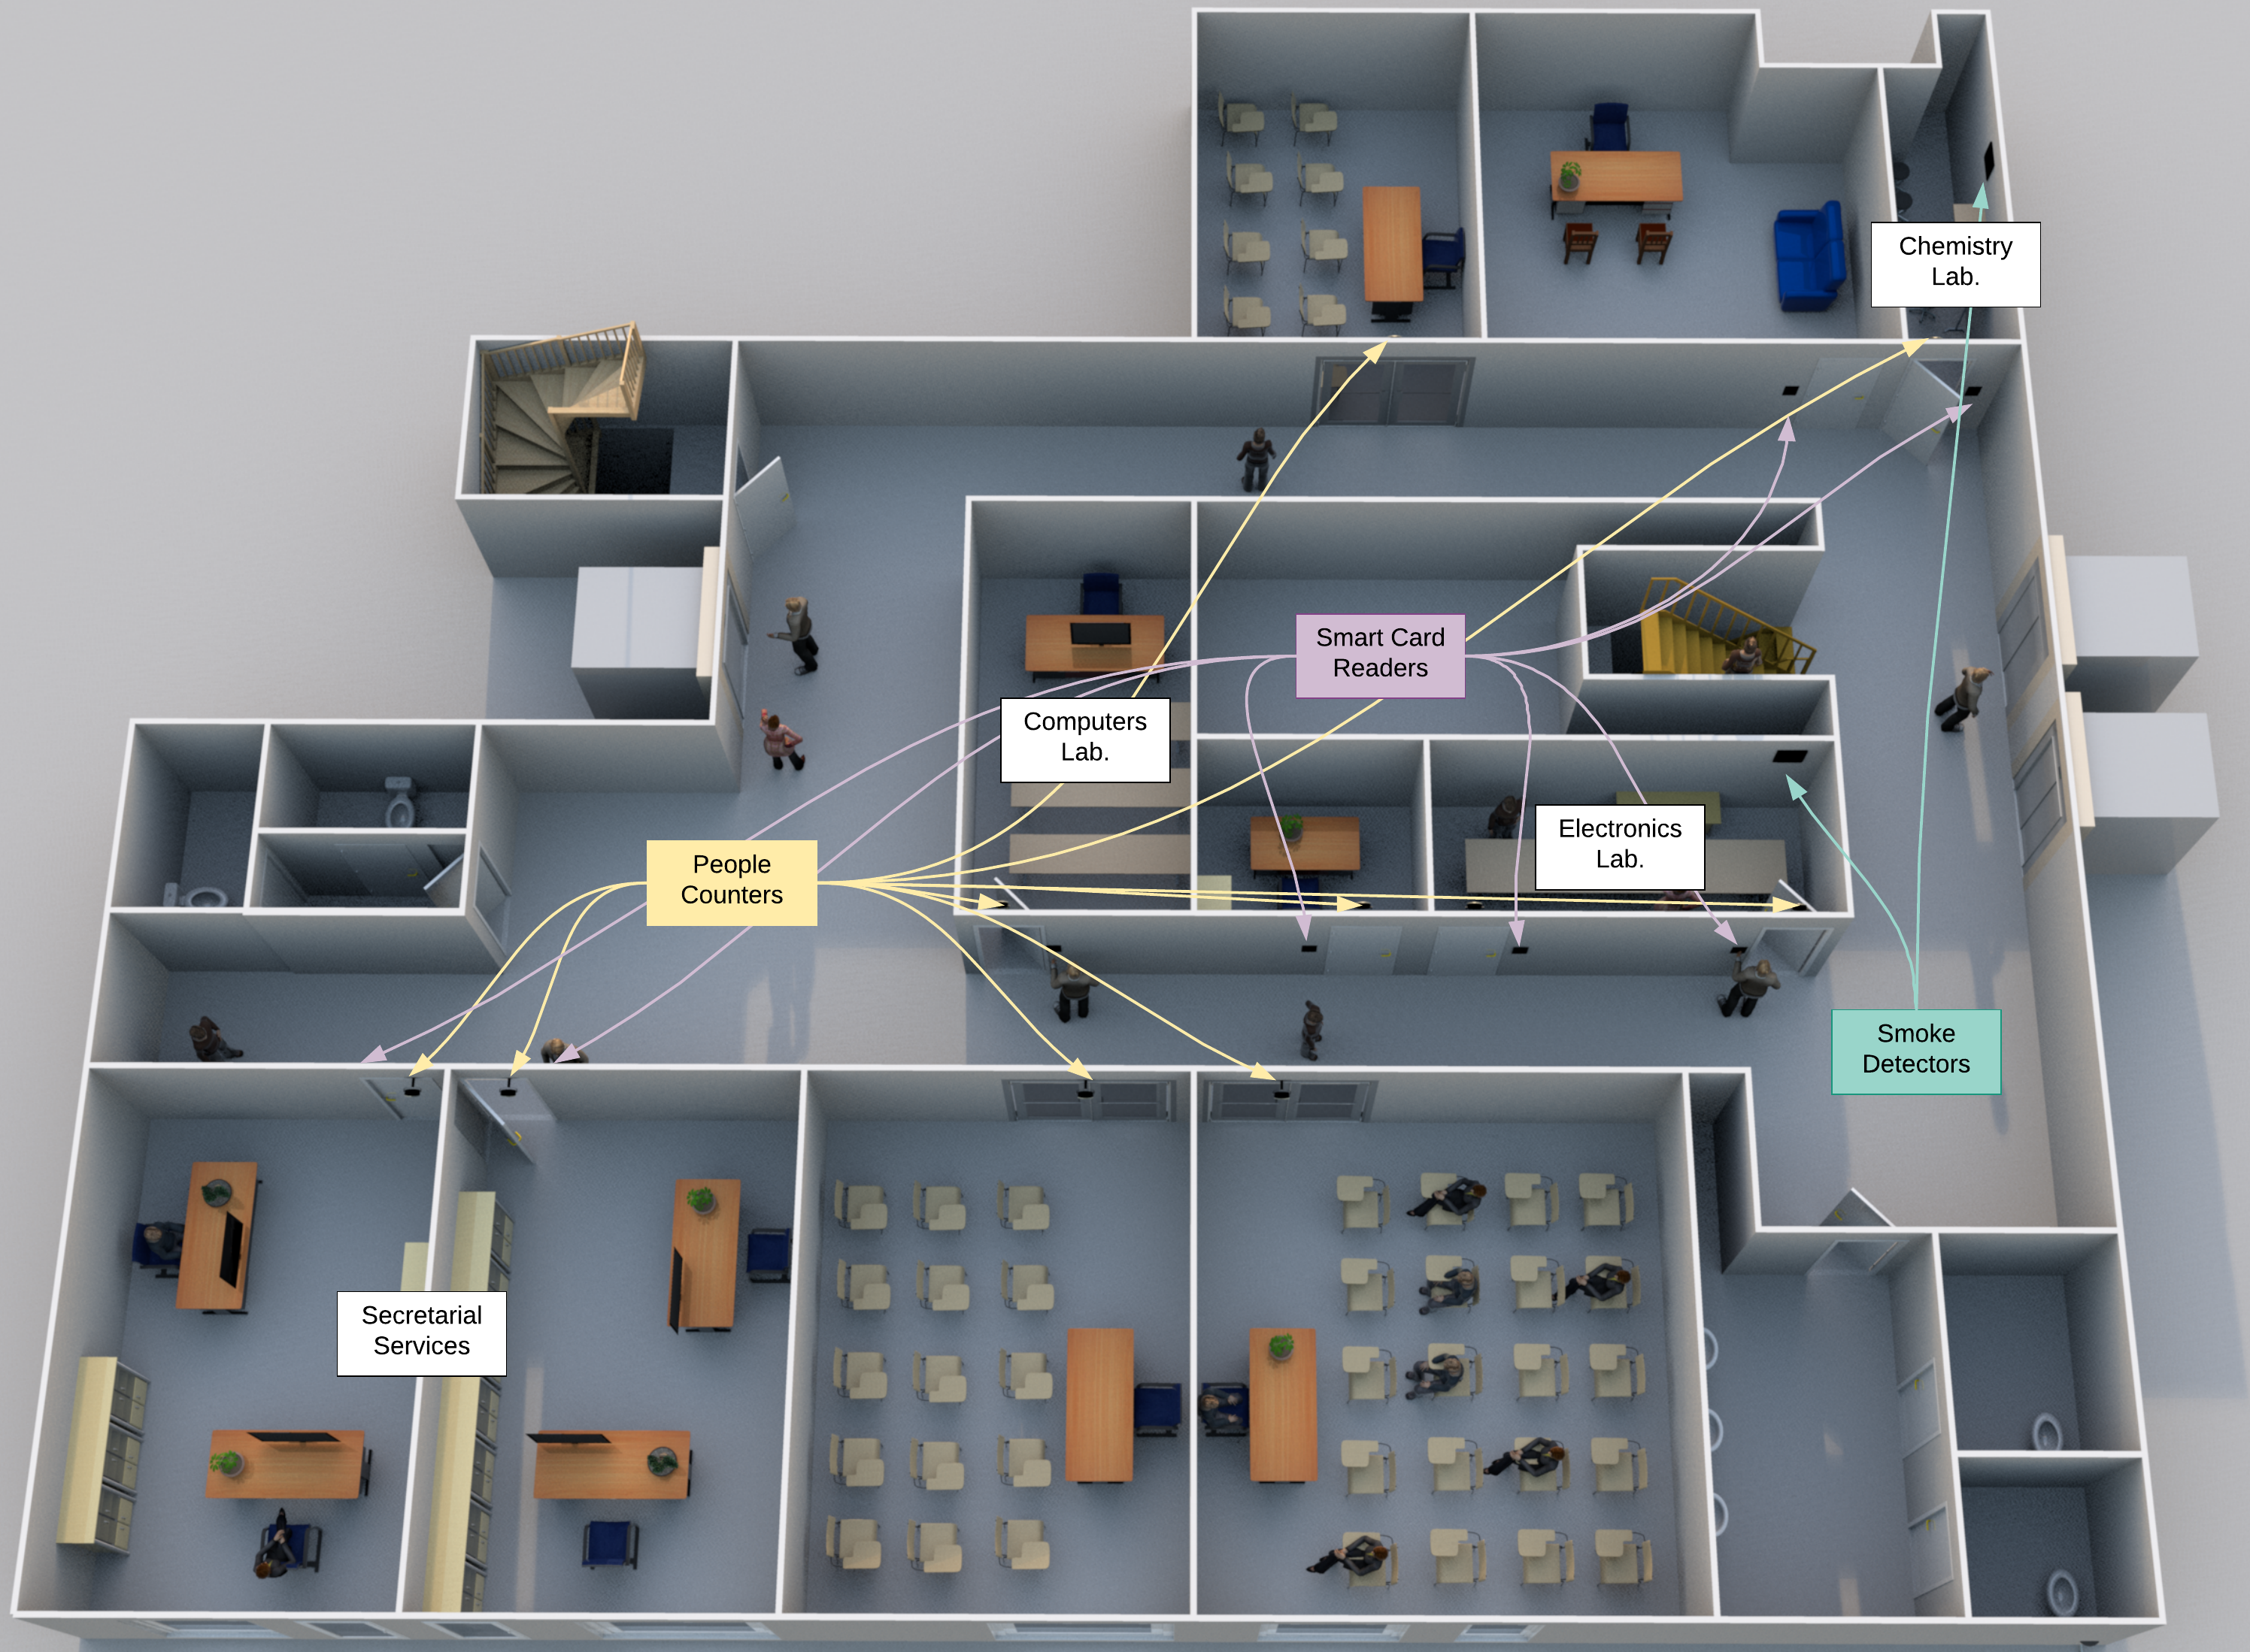
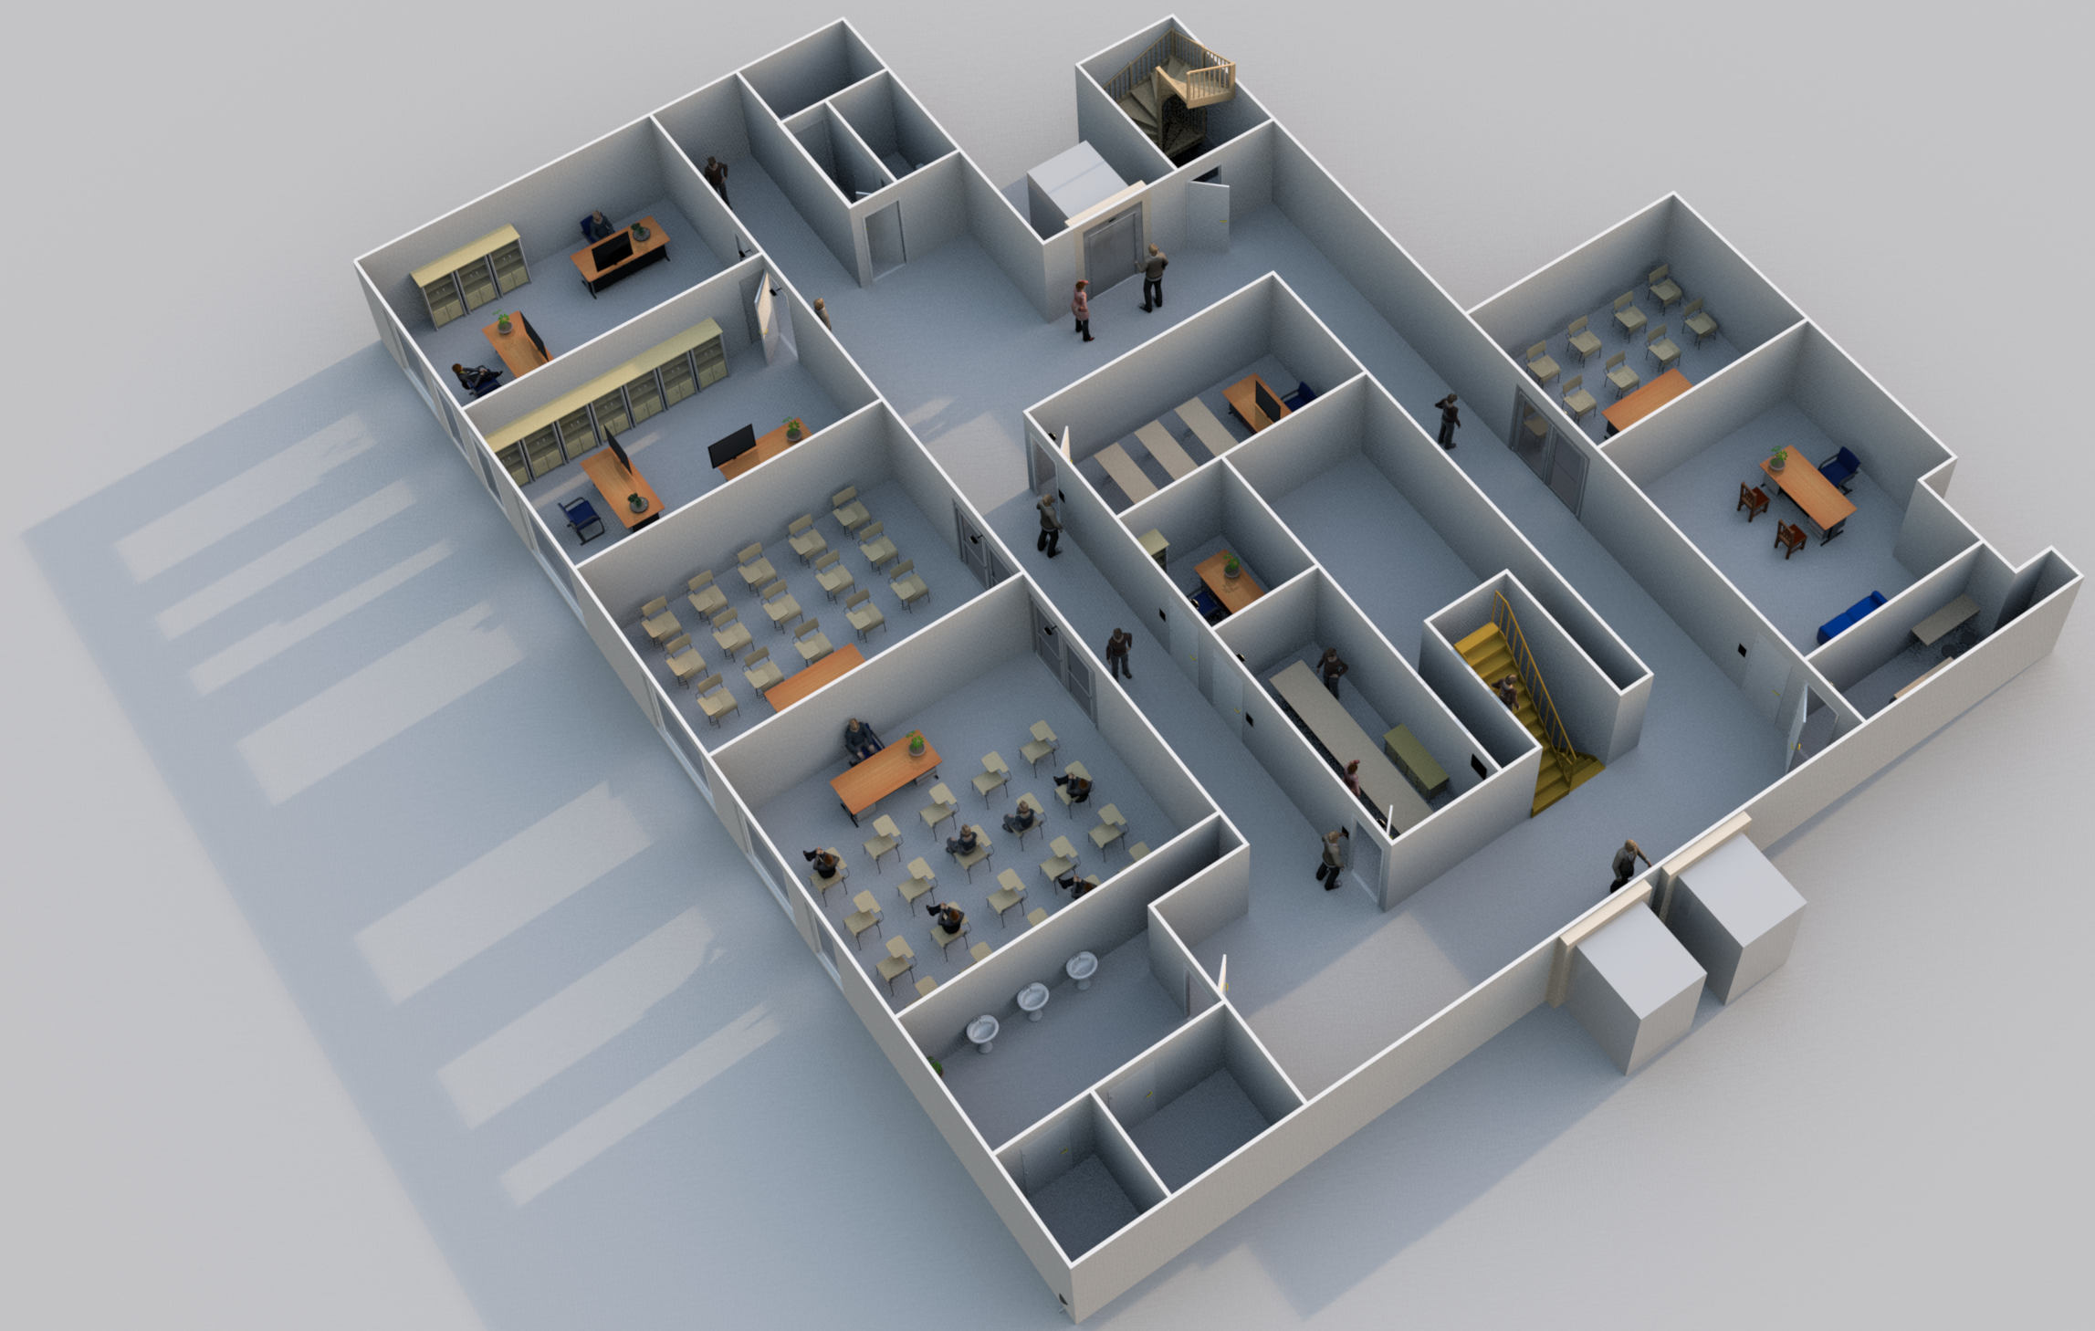
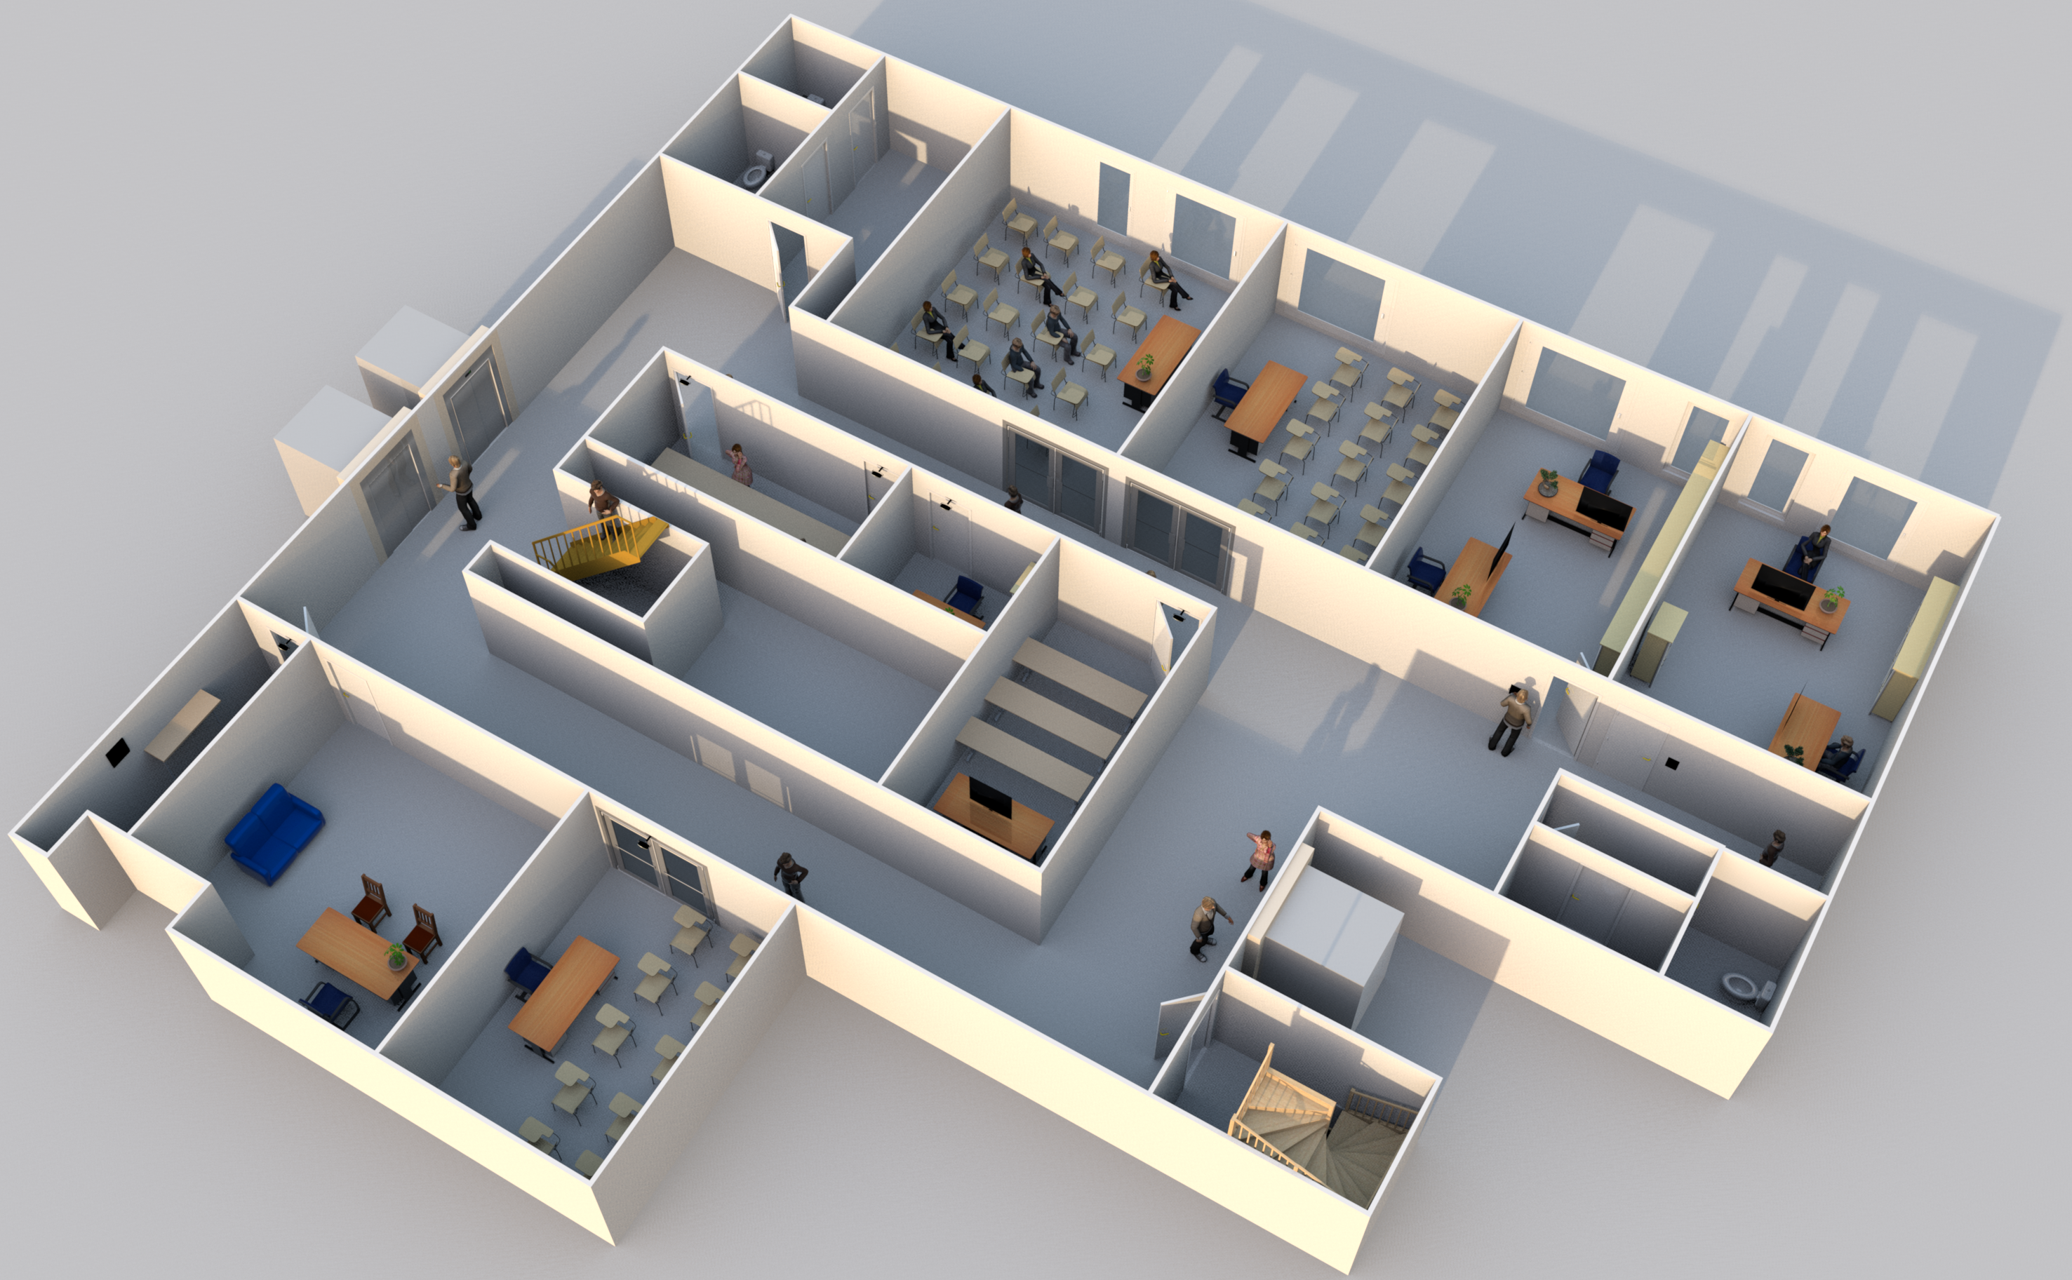
CAPS - ENVML

Slide 10
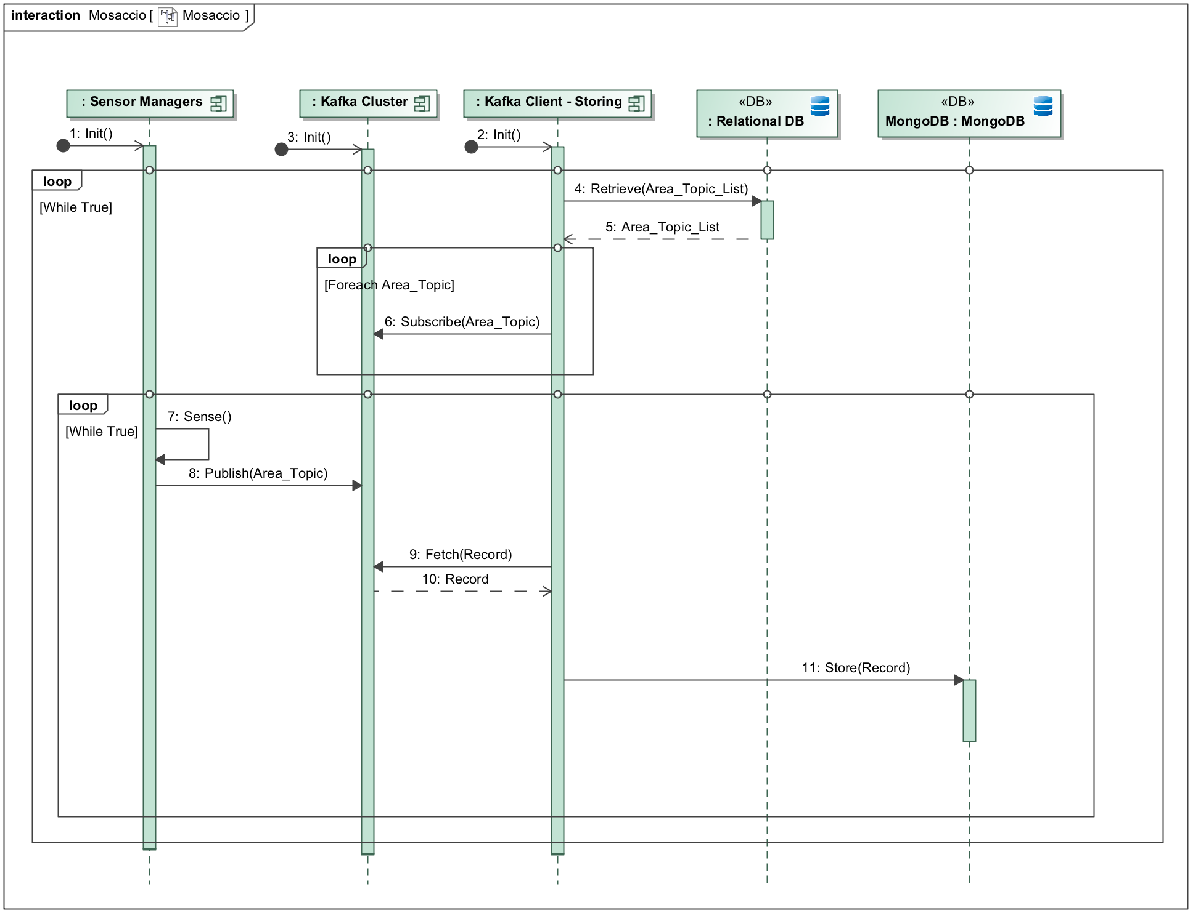
Implemented Service (D2) - Storing
This is the procedure that is responsible to the collection of the sensed data and the storing on the databases.
We decided to first implement this feature because it is the core functionality on which all the other ones are based on.
This allowed us to test the performance/usability/behavior of the system.

Slide 11
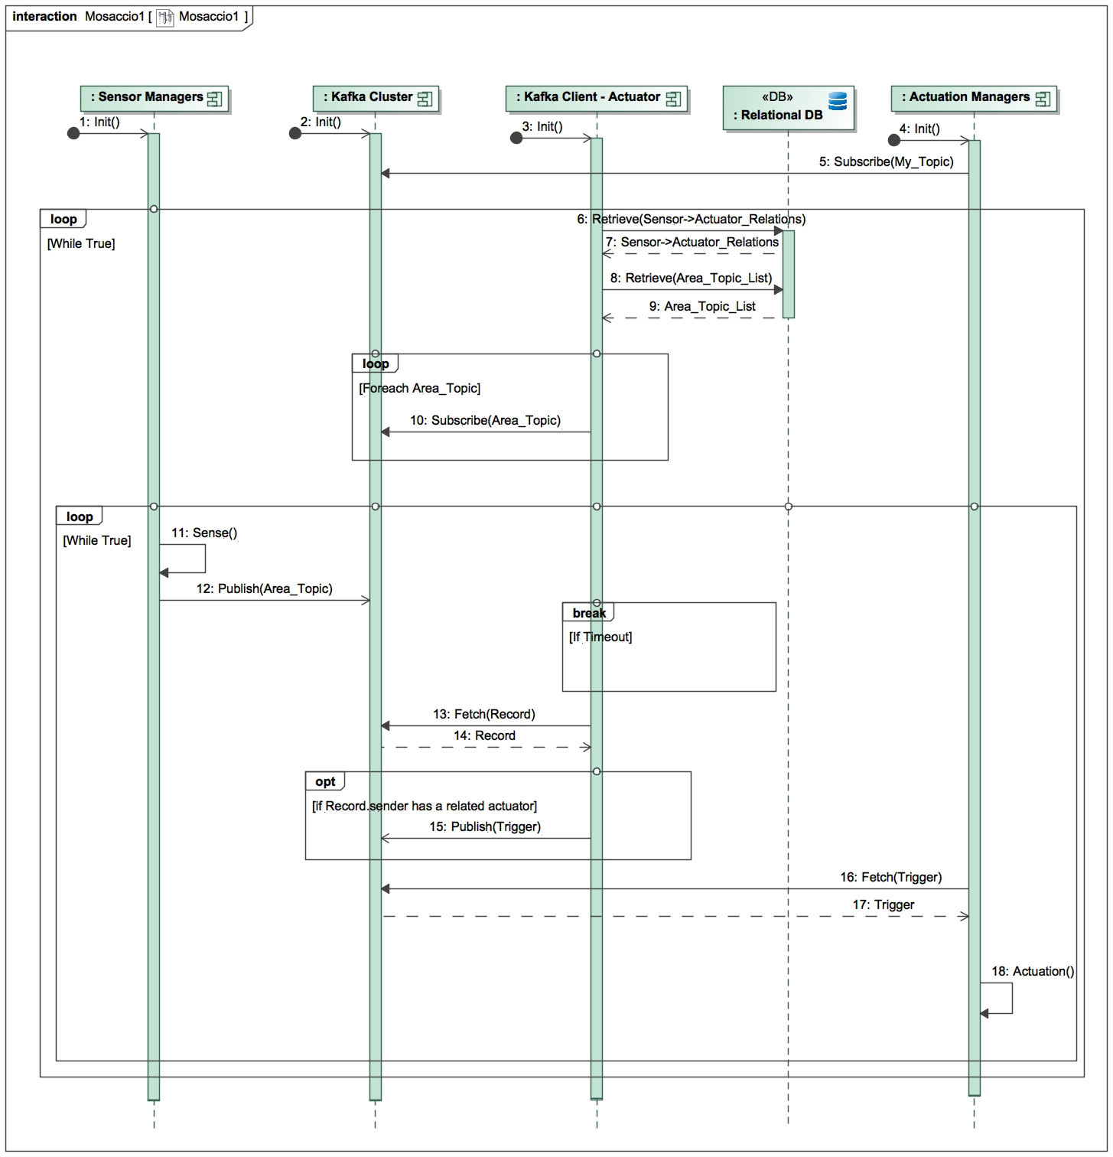
Implemented Service (D3) - Actuation
The actuation service consists of the triggering of some actuators when a certain sensor senses a certain event (e.g. a user slides his card on a card reader → the door opens).
The implementation of this service allowed us to further test our architecture, adding components and seeing how they can work together.

Slide 12
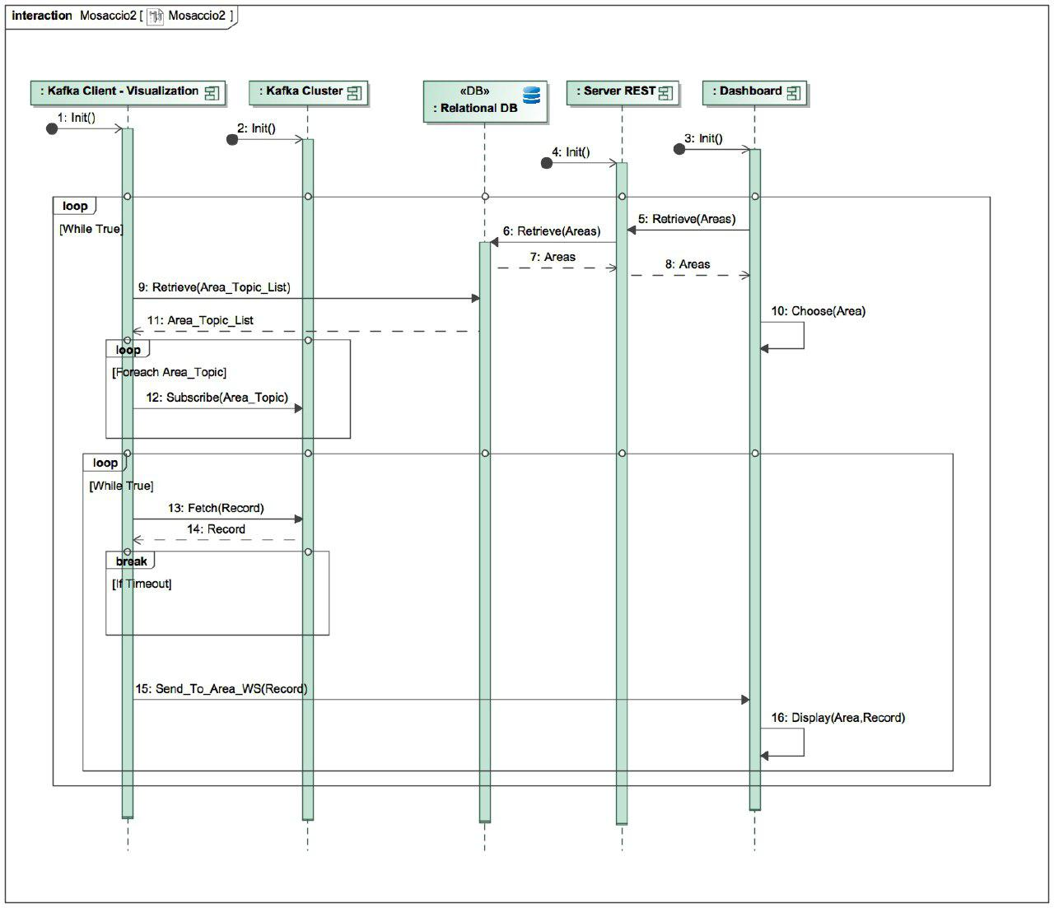
Implemented Service (D4) - Visualization
This service allows the personnel to visualize the data sensed by the sensors in a particular area.
In general, it allows to manage the system.
The implementation of this service allows us to demonstrate how the data can be visualized and handled in real-time, even if other crucial components such as the Storing Client and the Actuation Client are not running.

Slide 13
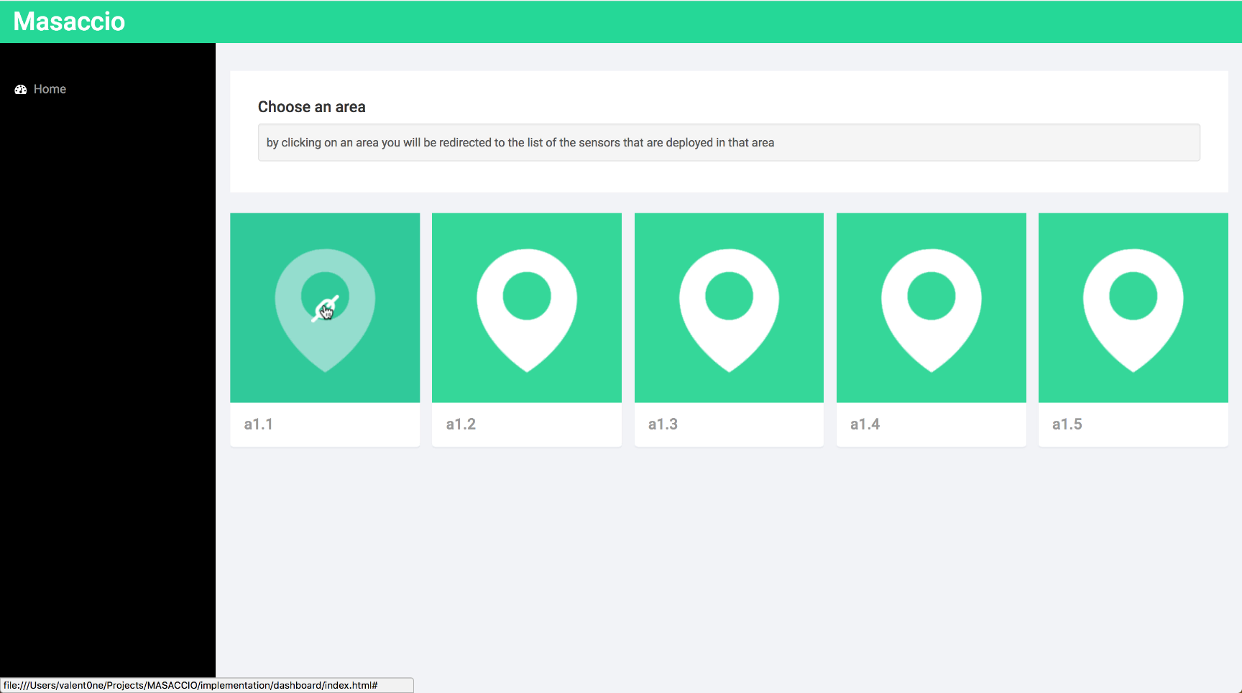
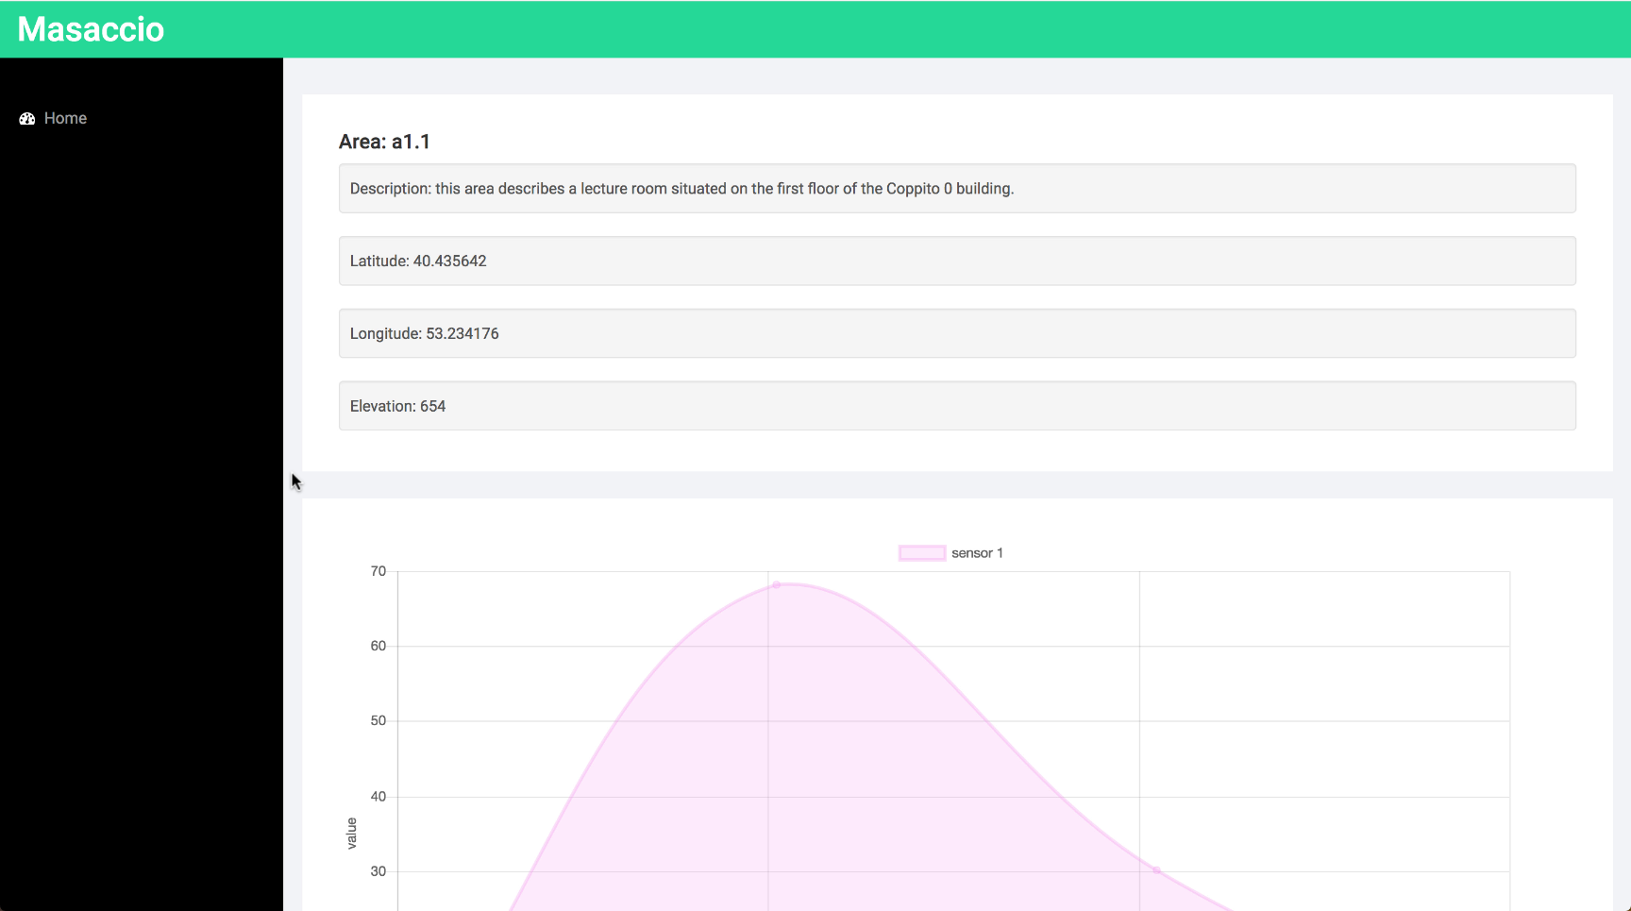
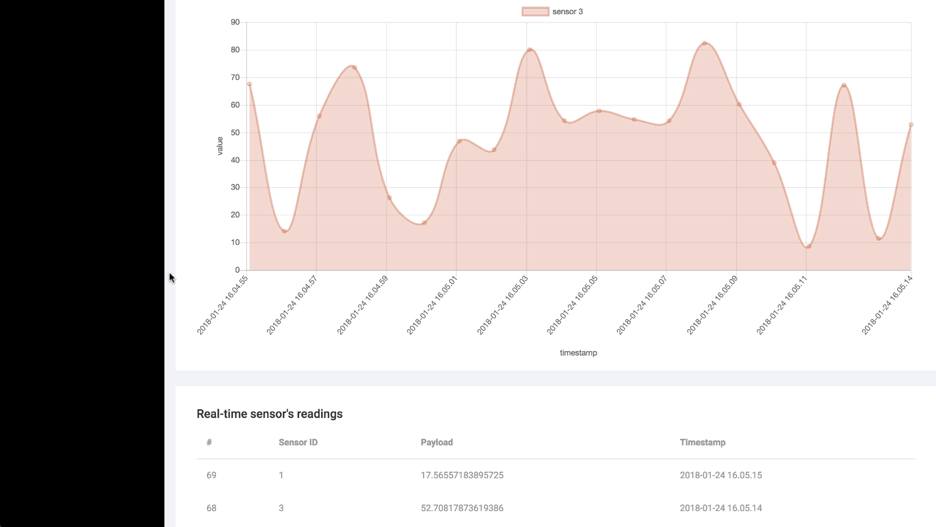
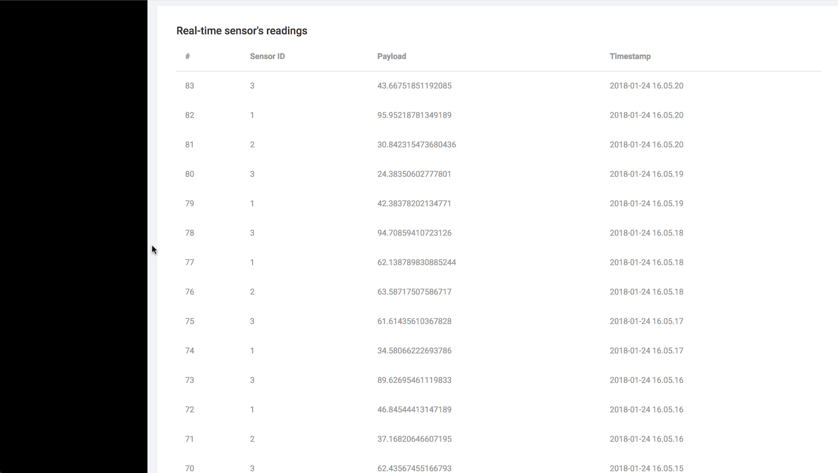

Slide 14
Performance Analysis
This test was made on a network composed by three laptops.
From the table at the right we can assert that the numbers we got are much higher with respect to the customer’s required numbers (40.000/hour <<< 240.000/13s).
So, we can conclude that the system is fully capable of handling the requested amount of data traffic.
kind of operation | # of topics | # of messages per topic | # of total messages | time (seconds) | kind of message
Publish (produce) | 6 | 40.000 | 240.000 | 13.817 | String
Subscribe (consume) | 6 | 40.000 | 240.000 | 15.341 | String
Store (from String to .json) | - | - | 240.000 | real-time/asynchronous | .json

Slide 15
Thank you for the attention
Questions?

